Slide 1


TRAVEL INSURANCE PREDICTION
Cindy Yang
Institute of Data
Data Science and AI Cohort
Capstone Project

Slide 2

Agenda
My Background
Research Questions
Data Collection
Exploratory analysis
Modelling
Recommendations

Slide 3
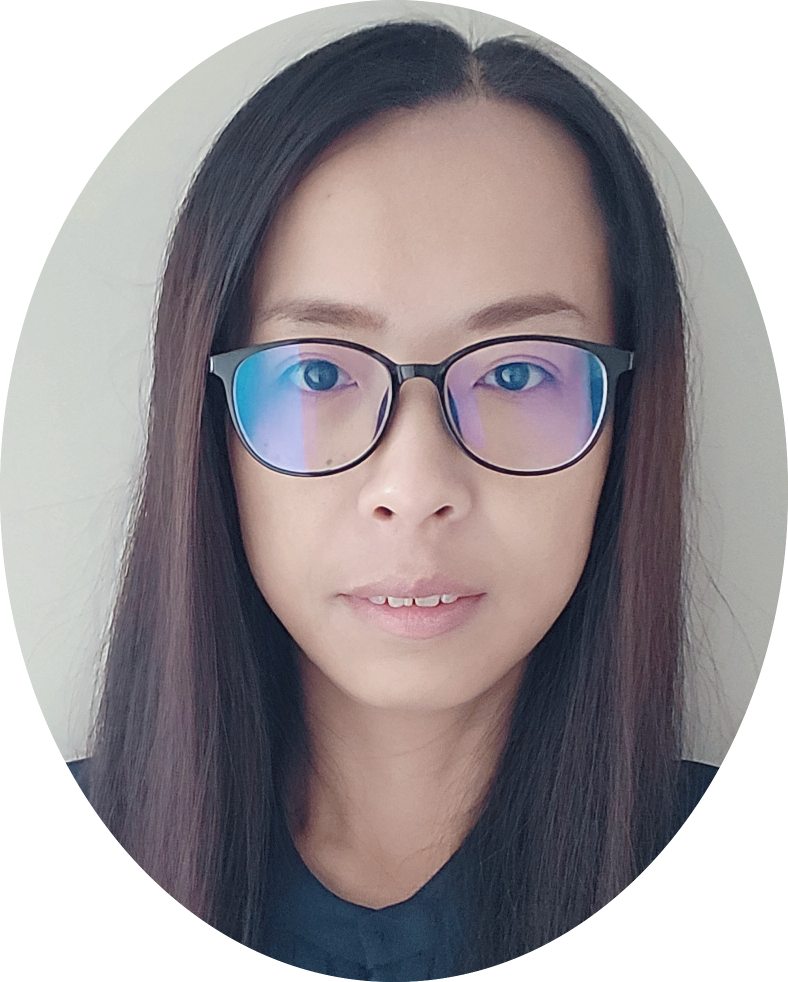
Bio
I am Cindy Yang.
Bachelor of Business Studies (Major in Finance, Massey University)
Professional Experience Over 16 years work experience in NZ Government sector, with an in-depth and comprehensive knowledge of the Police Prosecution Service.
Data science learnings and experience Technical skills include Python and SQL with practical experience in Mini Project and capstone project at the Institute of Data.
Mini project 1 -> EDA for Crime Data in Los Angeles
Mini project 2 -> Electric Vehicle Range Prediction - Regression Analysis
Mini project 3 -> Diamonds Clustering - KMeans, DBSCAN, KNN(PCA)
Capstone project -> Travel Insurance Prediction

Slide 4
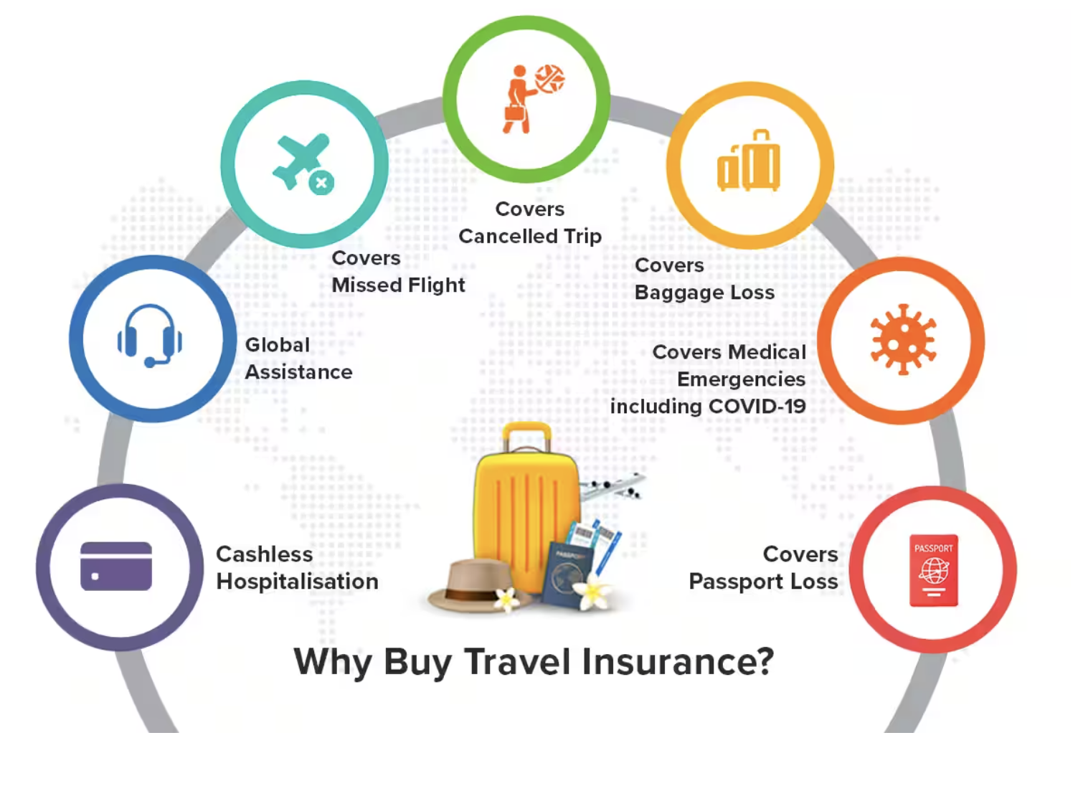
Project Context
Tour and Travel company
Offer COVID-Cover travel insurance package
Increase demand for travel insurance with Covid-cover due to COVID-19 pandemic

Slide 5


Business Questions
Can we accurately predict the likelihood of a customer purchasing a travel insurance package?
How can we help a company increase sale of their travel insurance package?

Slide 6
Data Pipeline
Data Source
Exploratory Data Analysis
Preprocessing & Feature Engineering
Model Evaluation
Data Source
Preprocessing & Feature Engineering
Exploratory Data Analysis
Model Evaluation

Slide 7

Data Source
Kaggle : https://www.kaggle.com/datasets/tejashvi14/travel-insurance-prediction-data?datasetId=1457162&sortBy=voteCount
Dataset: demographic and travel attributes, 1987 customers, 9 features
Features : Age, Family Members, Annual Income, Employment Type, Education Level, Chronic Diseases, Frequent Flyer, Travel History, Travel Insurance

Slide 8




Exploratory Data Analysis
1,987 rows
9 columns
No Null Values
5 numerical features
4 categorical features
No potential outliers

Slide 9
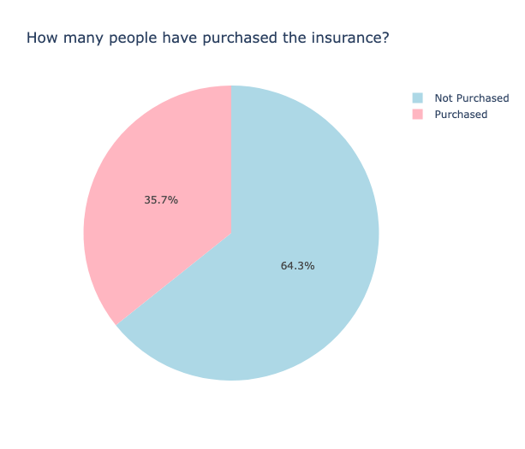
35.7% purchased travel insurance

Slide 10
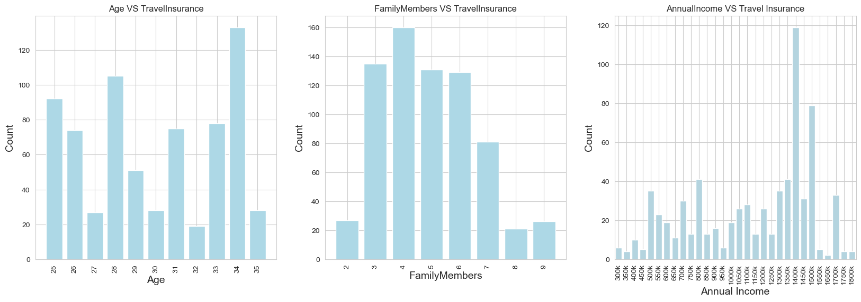
34 years old highest purchase
family with 4 members highest purchase
1400K Rupees Income highest purchase

Slide 11
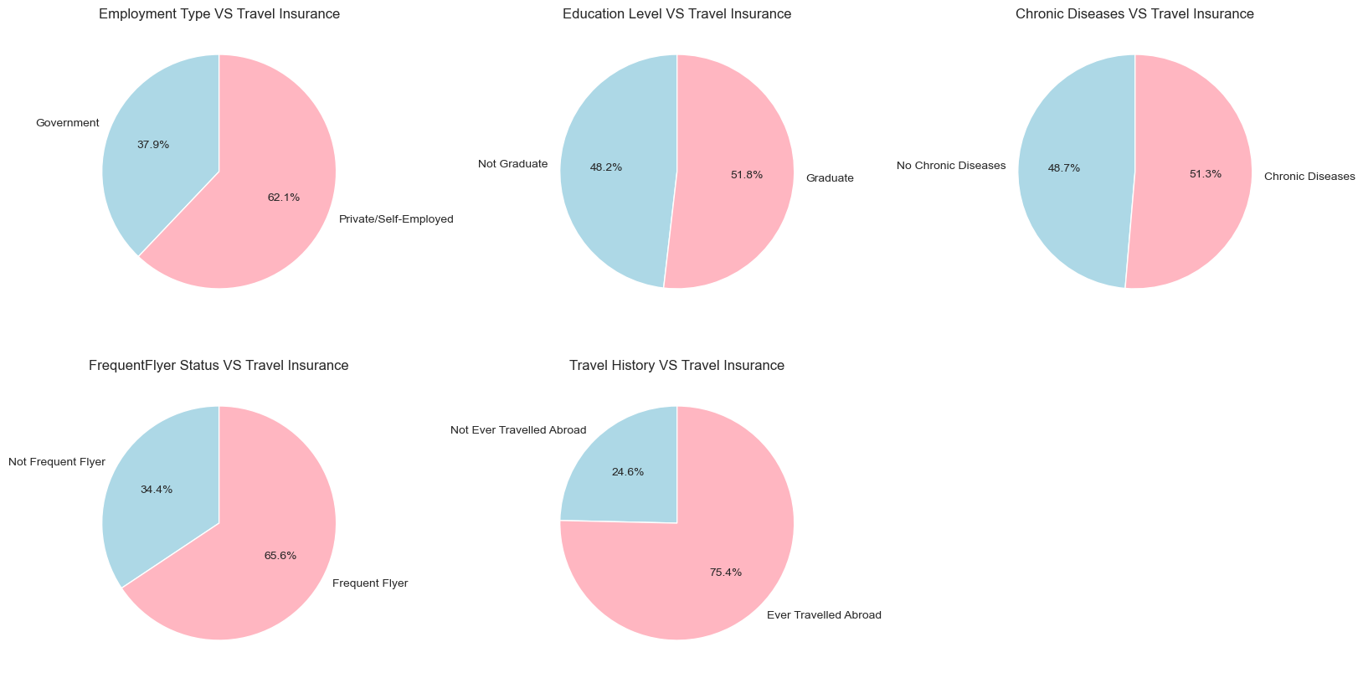
Graph Plot
Observations:
62.1% purchase - Private/Self-Employed
51.8% purchase - Graduate
51.3% purchase - Chronic Diseases
65.6% purchase - Frequent Flyer
75.4% purchase - Ever Travelled Abroad

Slide 12
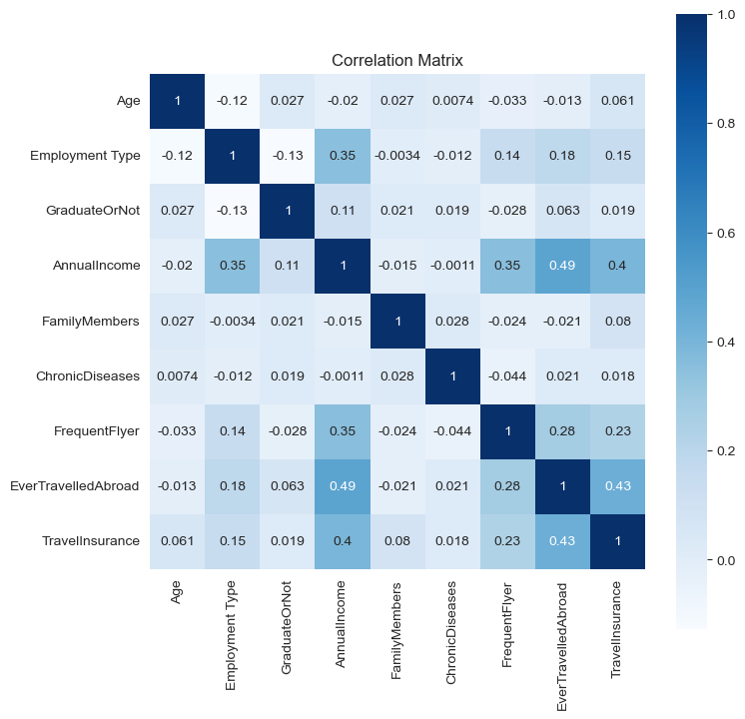
Correlation Heatmap
Observations:
Travel Insurance has strong positive relationship:
Ever Travelled Abroad
Annual Income
Frequent Flyer

Slide 13

Preprocessing & Feature Engineering
Convert categorical variables into numerical variables
Define the target variable as ‘Travel Insurance’
Split the data (test_size=0.2, random_state=42)
Set a seed = 100 for reproducibility
Feature Scaling - using Standard Scalar & MinMax Scalar

Slide 14

Model Selection
Logistic Regression (LR)
Decision Tree (DT)
Random Forest (RF)
k-Nearest Neighbours(KNN)
Naive Bayes (NB)
Support Vector Machines (SVC)

Slide 15
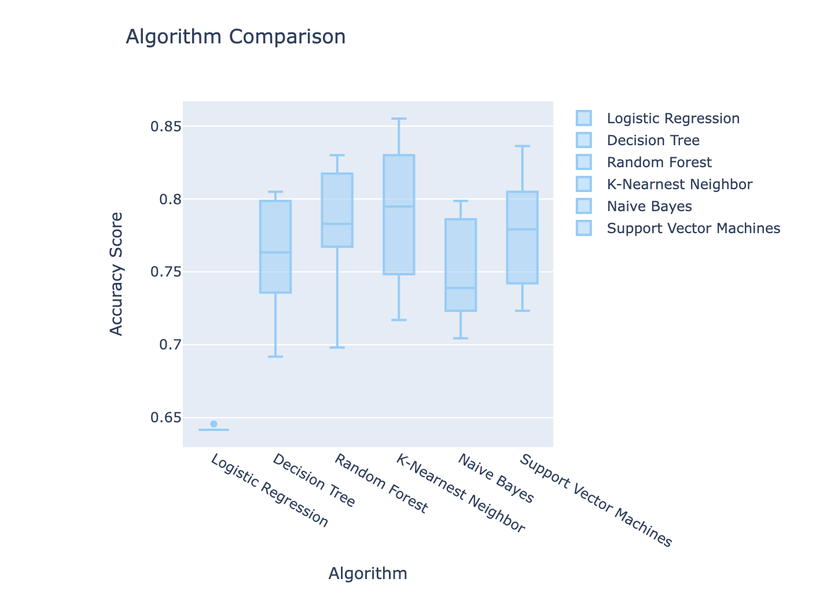
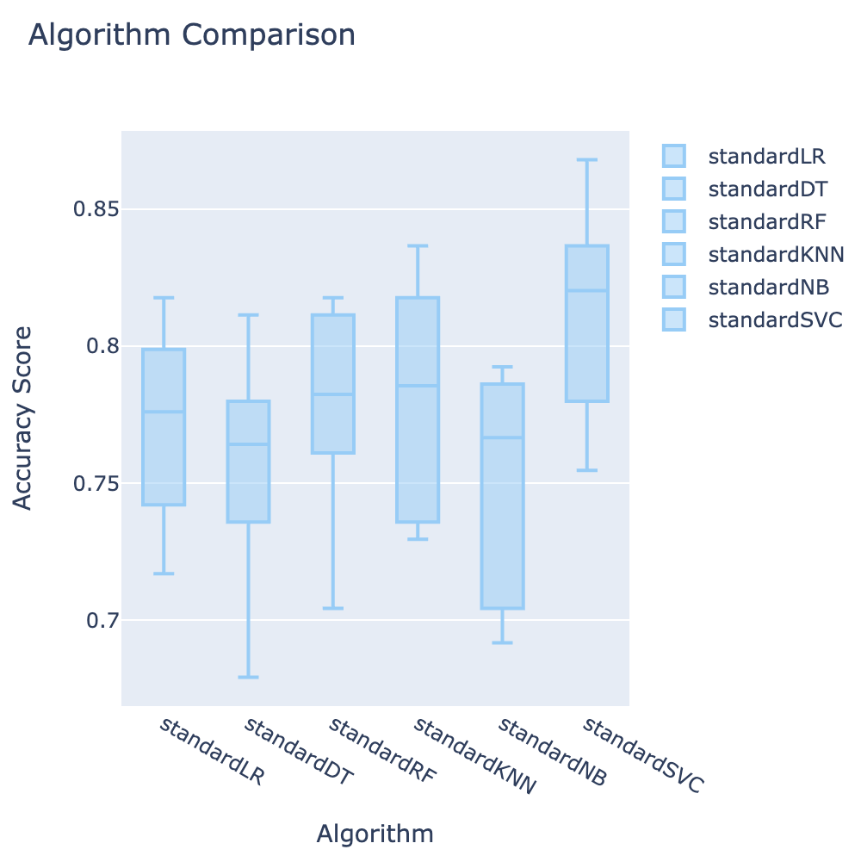
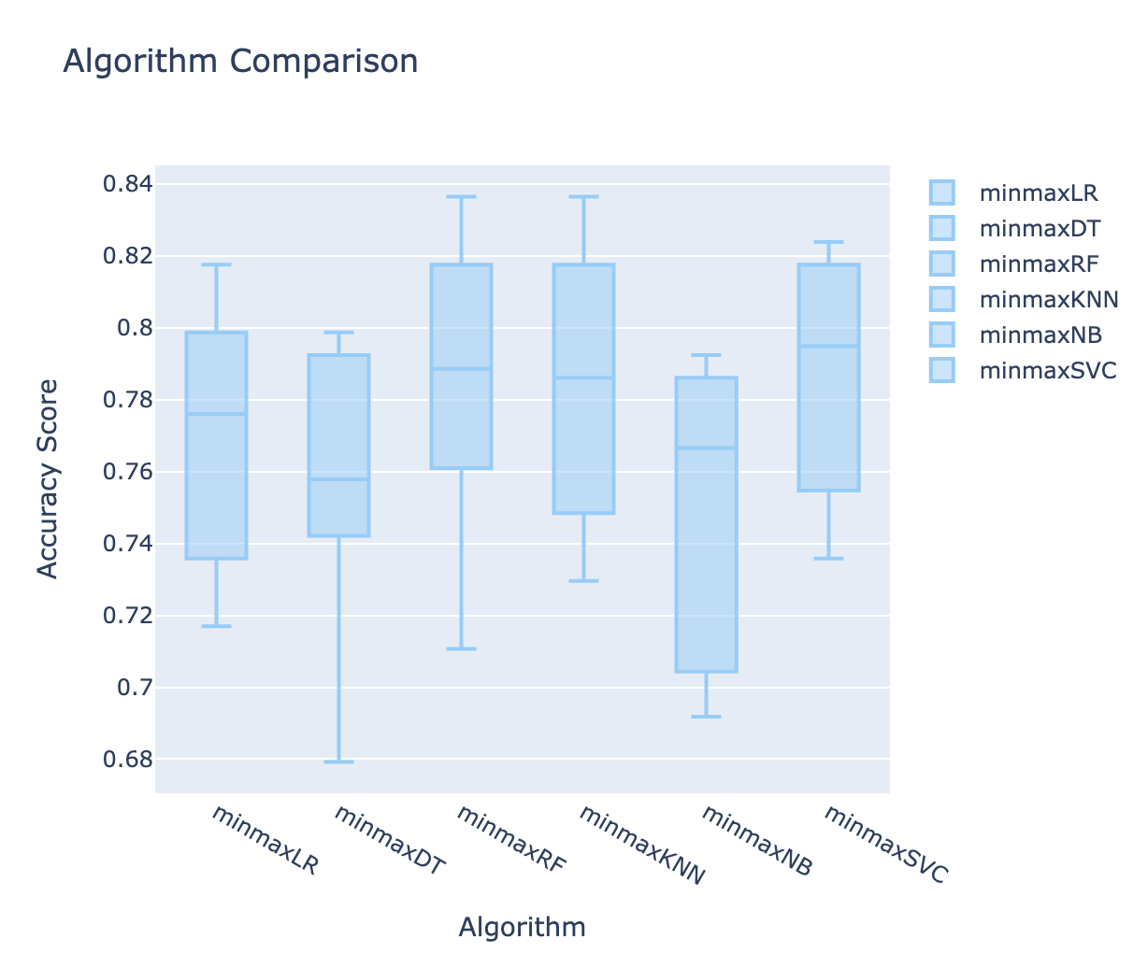
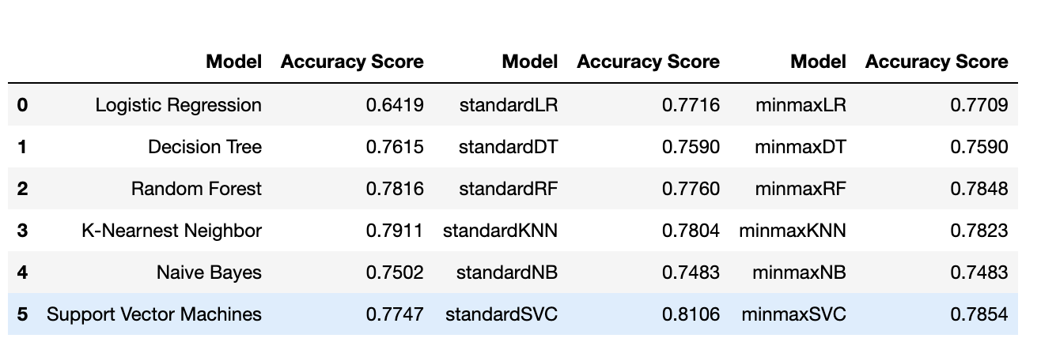
Model Comparison

Slide 16
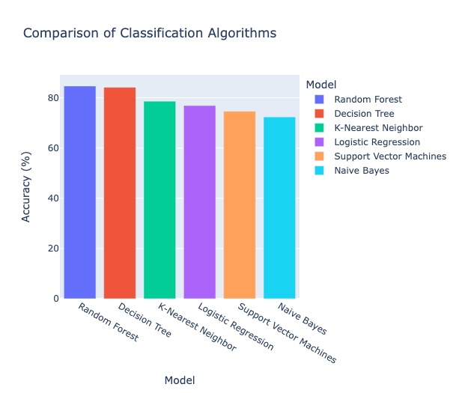
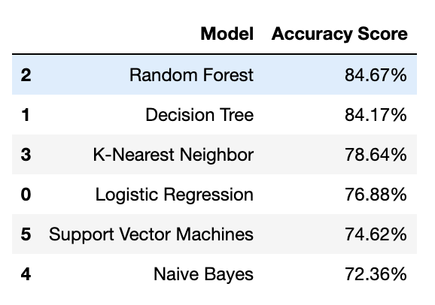
Model Evaluation

Slide 17
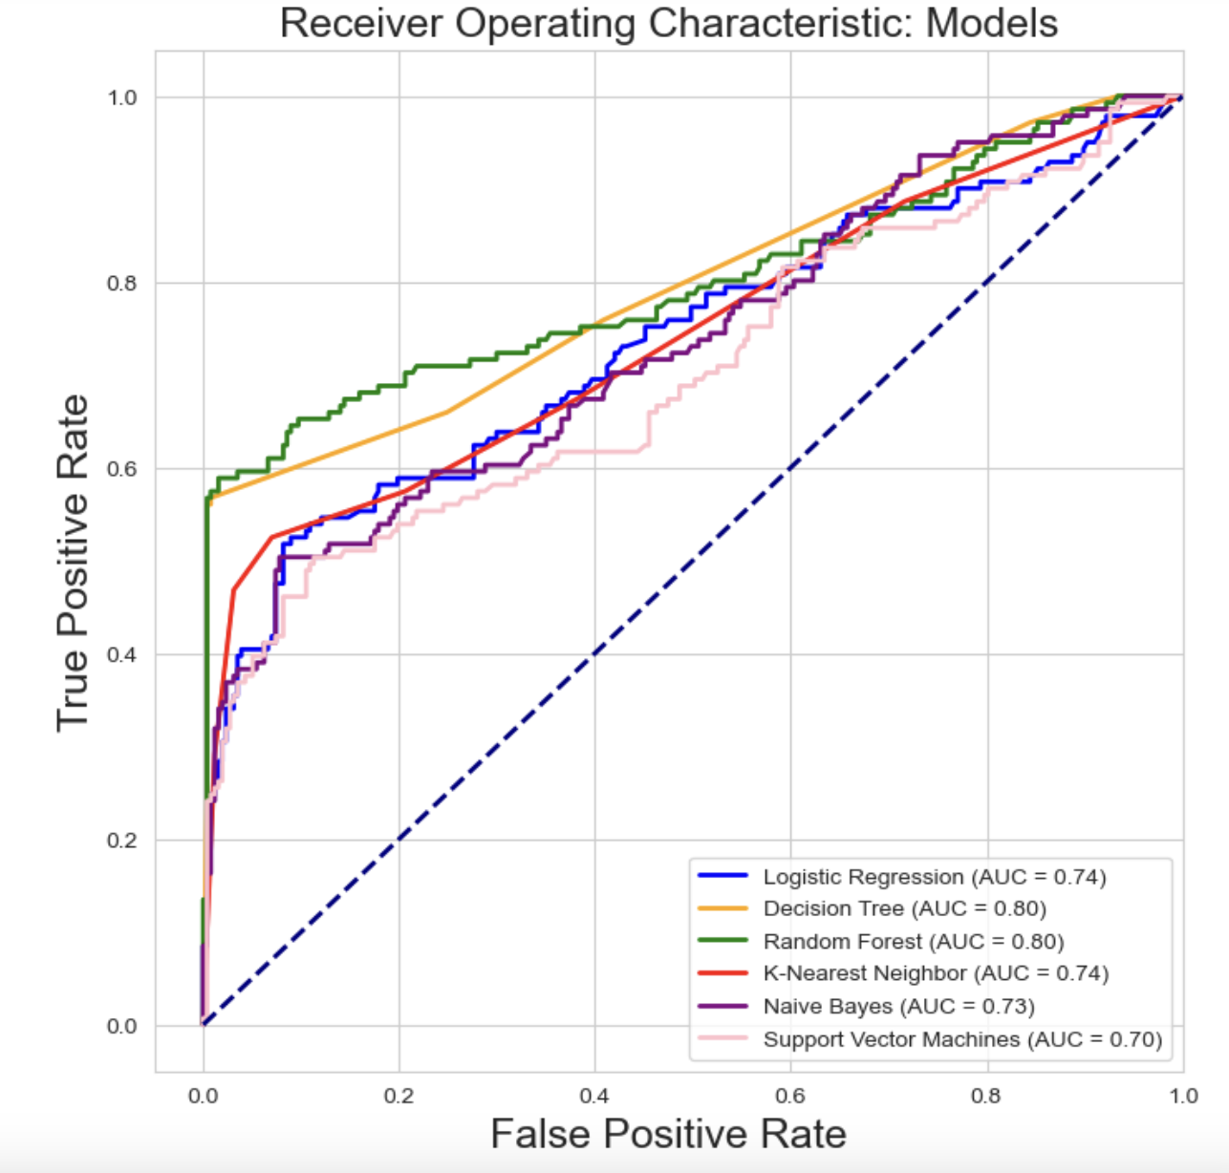
Plot the ROC curve for all models
Random Forest model provided the best AUC value of 0.80.

Slide 18

Summary
Random Forest algorithm achieved highest accuracy and AUC after GridSearch optimization
Feature engineering and additional data can enhance model performance
Consider advanced modeling techniques like deep learning for improved accuracy

Slide 19

Next Steps
Recommendations to Business team:
Investigate features that influence customer decisions and inform marketing strategies
Monitor and retrain machine learning models for accurate targeting of relevant customers
Improve marketing strategy by targeting advertising and offering incentives to customers likely to purchase travel insurance
Use social media and web browsing behavior data to better understand customer preferences
Conduct A/B tests to compare different marketing strategies and tactics
Regularly evaluate package success and adjust marketing strategies to optimize performance and achieve goals

Slide 20
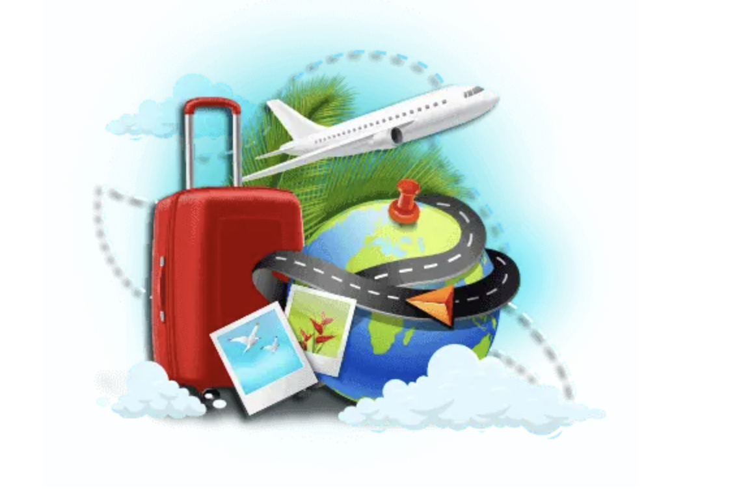
THANKS!
Any questions?
You can find me : 0211354999 (Mobile) &
cindy_yang_nz@yahoo.com (Email)

